Slide 1
Viva Presentation
Predicting Individual Physiological Responses toPollutionUsing Transformer–Based Time-Series Models
05.09.2025

Slide 2
Agenda
Aim (1min)
Dataset - 1min
Model – 2mins
Results – 3min
Conclusions - 1min
Q&A

Slide 3
Aim
Air pollution contributes to an estimated seven million deaths annually
Most of research does not show how predicted pollution affect individuals
The aim is then to predict individual health responses to pollution exposure, facilitating early warnings and personalised health recommendations.
Why?

Slide 4

The Inhale Dataset
Merged respiratory and personally experienced level of pollution on patient id and timestamp.
Added personal levels of inhalation rate by multiplying tidal volume of air inhaled per patient to pollution levels in the air inhaled
What?
Copyright: Imperial Inhale project https://www.imperial.ac.uk/earth-science/research/research-projects/inhale/
Notes:
Tidal volume (TV) is the amount of air that moves in and out of the lungs with each normal, relaxed breath.
Physiological response is mostly useful because → As an example, consider two individuals who are both in the same place at the same time, but one is driving while the others jogging. Every individual belonging to a different group reacts differently to the same level of pollution.
Open weather → Basically tells you air quality and pollution level (up to 200 metres precise). Could I measure it as a distance from a station? It has to be up to a meter or what’s the calculation behind it?

Slide 5
Datasets
Merged on longitude, latitude, timestamp
OpenWeather Dataset (including pollution measures like pm2.5)
Inhale Dataset (including breath rate avg standard, activity level etc.)
What?
Notes:
Data was normalised and successfully filtered

Slide 6
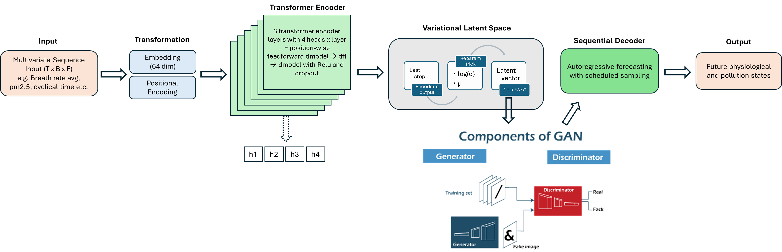
Model
How?

Slide 7
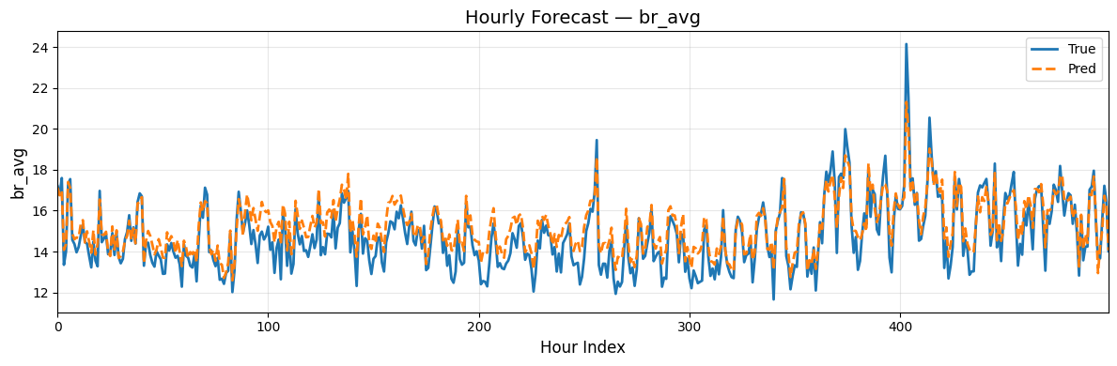
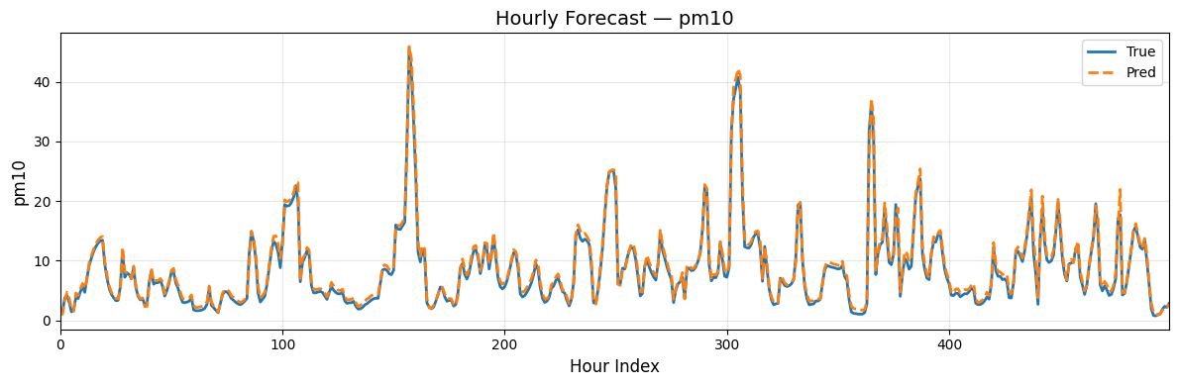
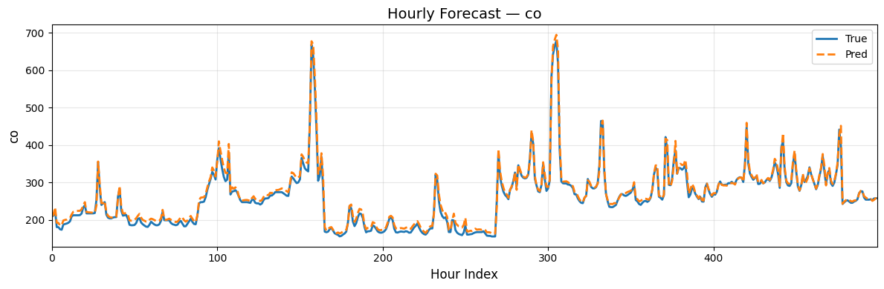
Results – population wide model
Predicting hourly physiological measures more challenging than pollution measures

Slide 8
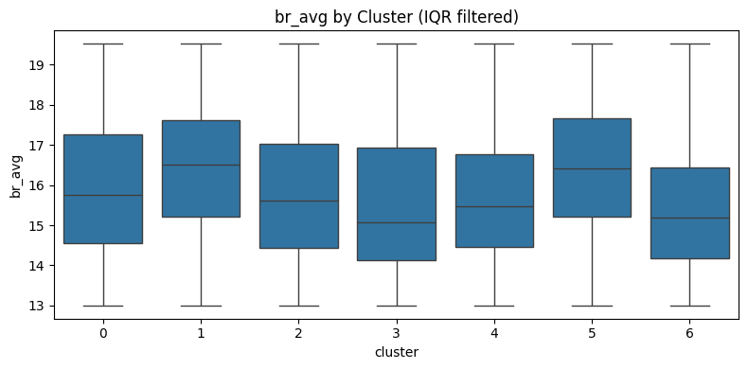
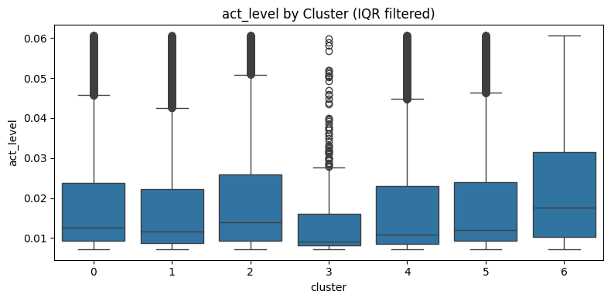
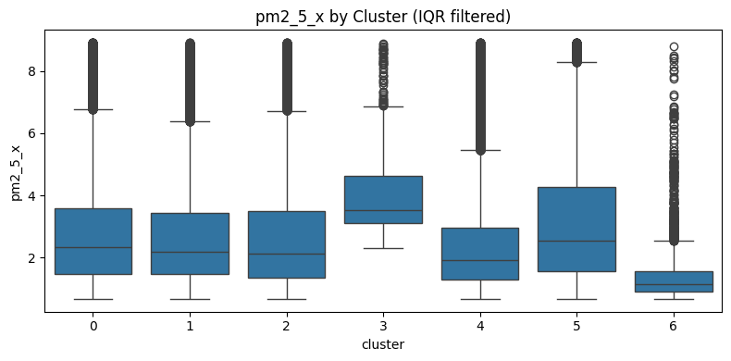
Reaction to pollution by clusters
Cluster 3 - highest levels of PM2.5 and PM10 levels and shows one of the largest increases in average breathing rate.
Cluster 4 - lower PM2.5 and PM10, higher activity levels are associated with the strongest breathing-rate response.
Cluster 0 - has modest PM2.5 but elevated O3 and SO2 relative to other clusters, consistent with vehicles and indoor pollution influences.

Slide 9
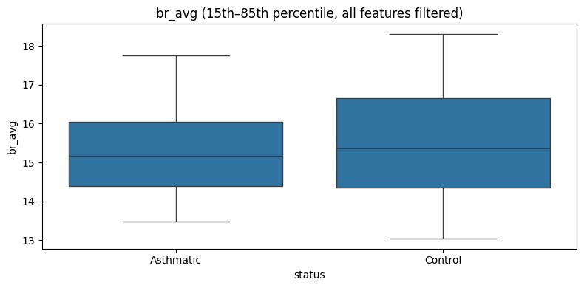
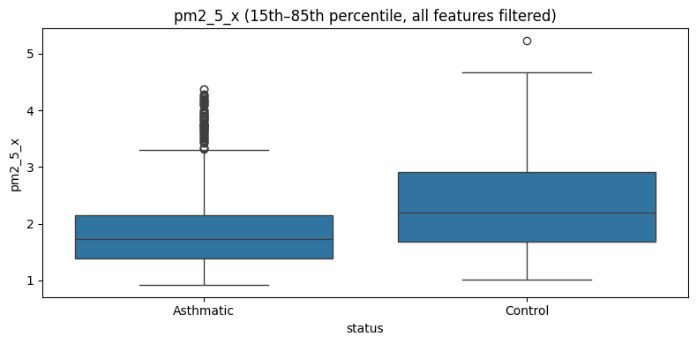
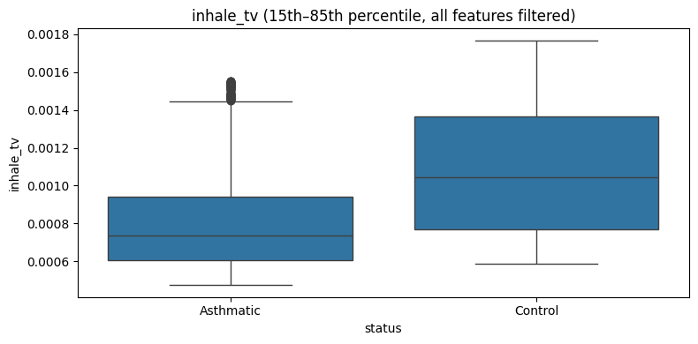
Reaction to pollution by health group
Control (healthy group) is reacting more to pollution than asthmatic
Control has higher level of pm2.5, pm10 . Greater inhalation and they have greater level of activity
Control inhale more polluted air than healthy

Slide 10
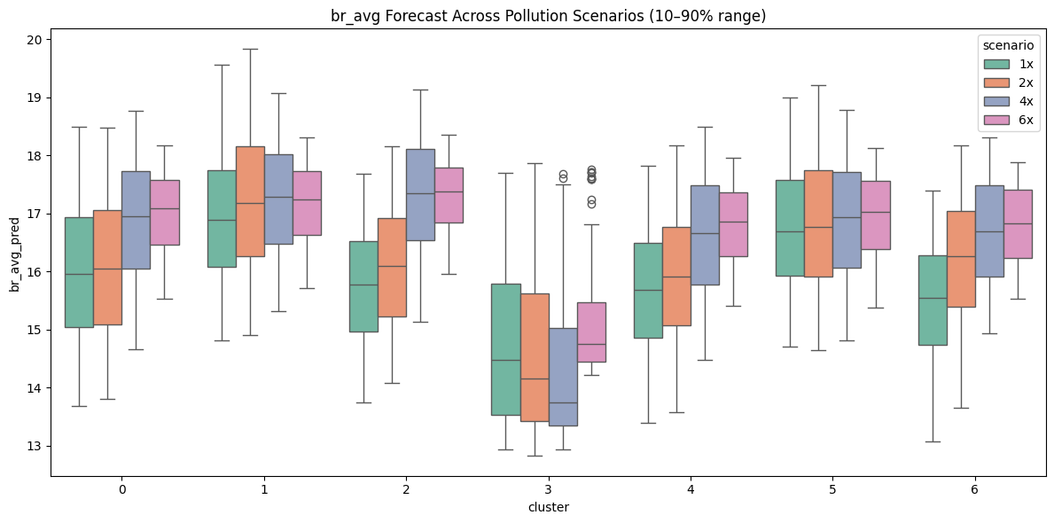
Perturbation multiplied by 1, 2, 4, 6 times of pollution measures
Greater levels of pollution suggest higher volatility within breathing rate, meaning more unstable breathing.
Clusters 0, 2, 4 and 6 seem to show the strongest reactivity, with breath rate rising by up to 10%.
Clusters 1 and 5 display only mild changes in average breath rate but reflect more erratic standard deviations, indicating spikier breathing patterns.

Slide 11
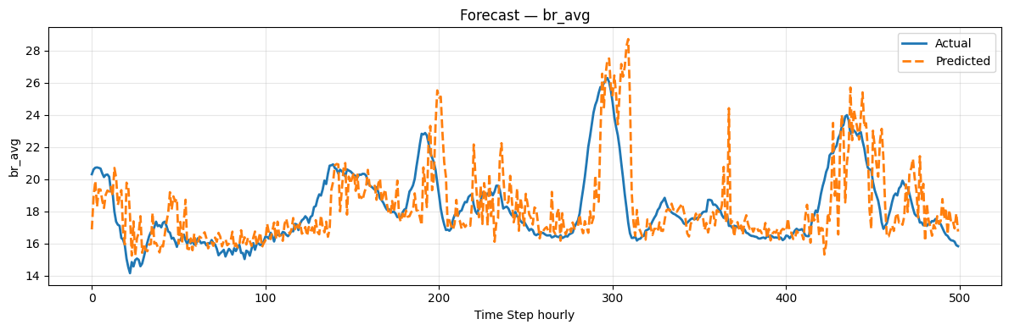
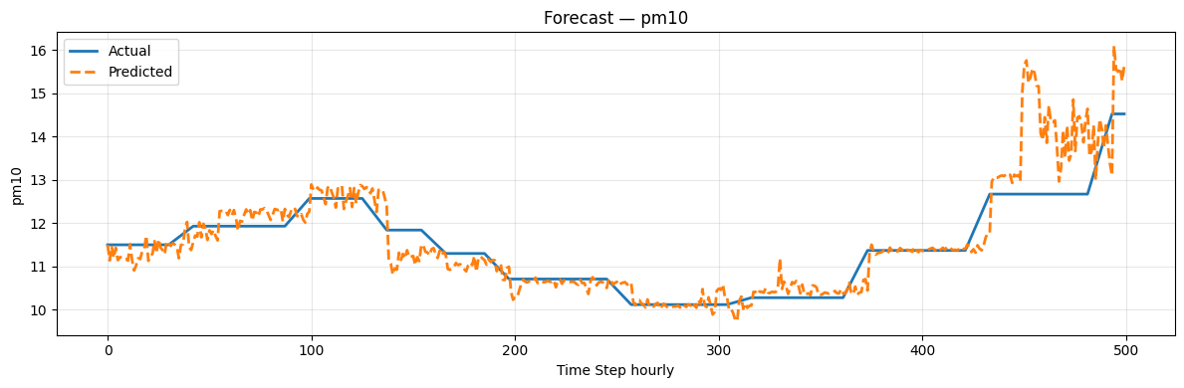
Fine tuned model can predict next hours for unseen data
Model successfully predicted next hour breath rate average so it learns from population and apply to unseen data
Fine-tuned model is also able to predict next few hours of pollution level, so it understands the relationship between the twp

Slide 12
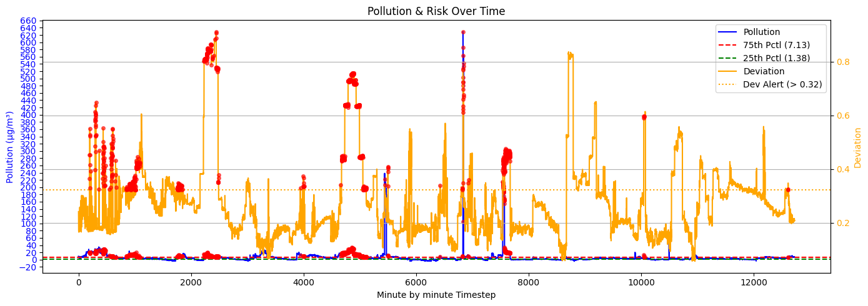
Alert system
There is a personalised baseline of expected physiology for individuals and deviations from it at every new timestep
Pollution exposure and physiological deviation are assessed against individualised thresholds. High risk is greater than 75%
An alert is triggered only when both thresholds are exceeded, so that we can infer that pollution and physiological are driven by one another

Slide 13
Conclusions
A Transformer VAE-GAN was trained on cleaned data to forecast future physiological and pollution measures, showing strong accuracy for both population trends and unseen individuals.
Clustering of latent spaces revealed groups with different sensitivities to pollution, with some clusters showing strong physiological reactions under high exposure.
A threshold-based alert system was developed to warn individuals of likely adverse reactions, supporting behaviour changes to reduce exposure.

Slide 14
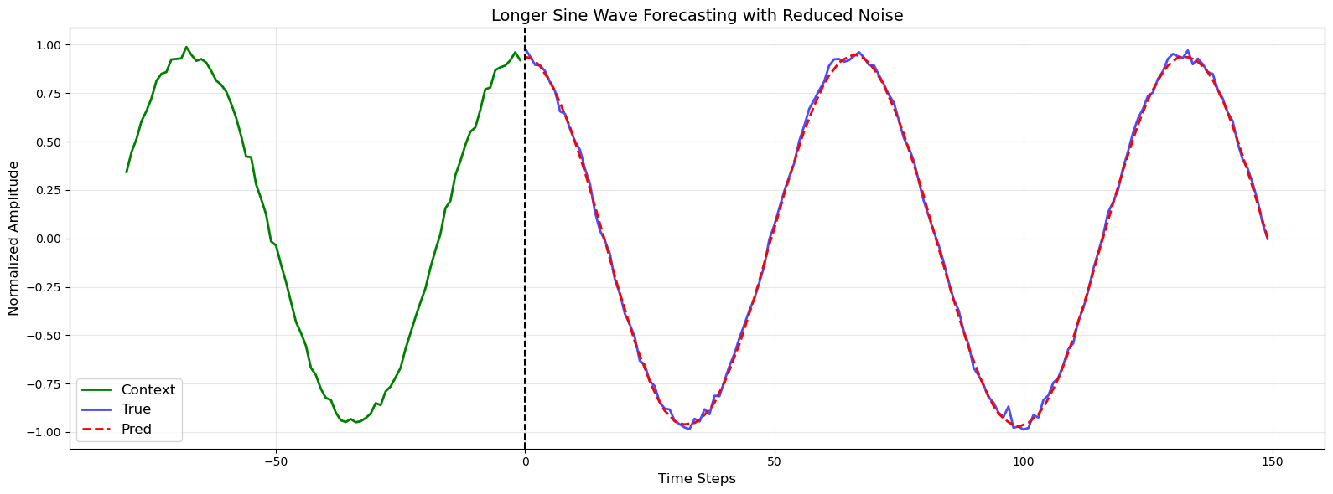
Time Series encoder decoder transformer Sine Forecasting

Slide 15
Datasets
Personal Exposure to pollution (Inhale → Patches etc has to be personal)
Pollution (Open Weather – up until 200 metres
Physiological Responses tracker (Fitbit, Garmin, Apple health)
“GPS Tracker”
Notes:
The point is that each dataset is unique. Any dataset alone doesn’t really add any value!
Physiological response is mostly useful because → As an example, consider two individuals who are both in the same place at the same time, but one is driving while the others jogging. Every individual belonging to a different group reacts differently to the same level of pollution.
Open weather → Basically tells you air quality and pollution level (up to 200 metres precise). Could I measure it as a distance from a station? It has to be up to a meter or what’s the calculation behind it?

Slide 16
Time Series encoder decoder transformer Sine Forecasting

Slide 17
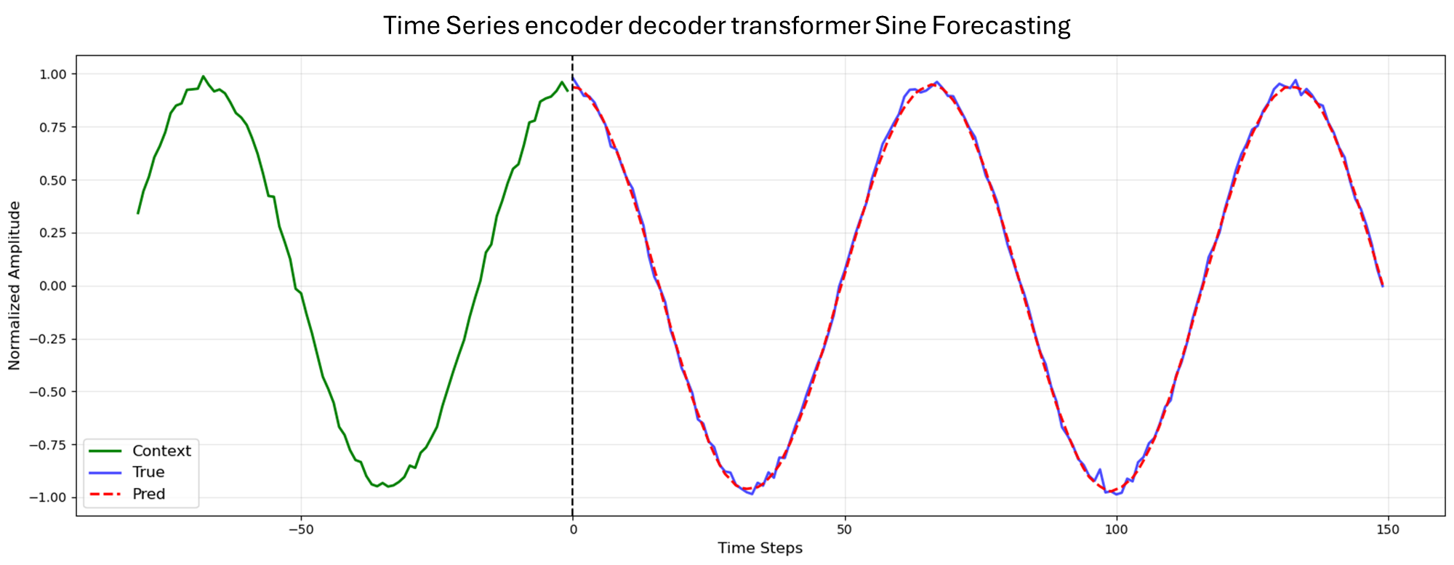

Slide 18

Personal Exposure to pollution (Inhale → Patches etc has to be personal)
(Open Weather) – granularity up to 200m
“GPS coordinates”
Notes:
The point is that each dataset is unique. Any dataset alone doesn’t really add any value!
Physiological response is mostly useful because → As an example, consider two individuals who are both in the same place at the same time, but one is driving while the others jogging. Every individual belonging to a different group reacts differently to the same level of pollution.
Open weather → Basically tells you air quality and pollution level (up to 200 metres precise). Could I measure it as a distance from a station? It has to be up to a meter or what’s the calculation behind it?

Slide 19
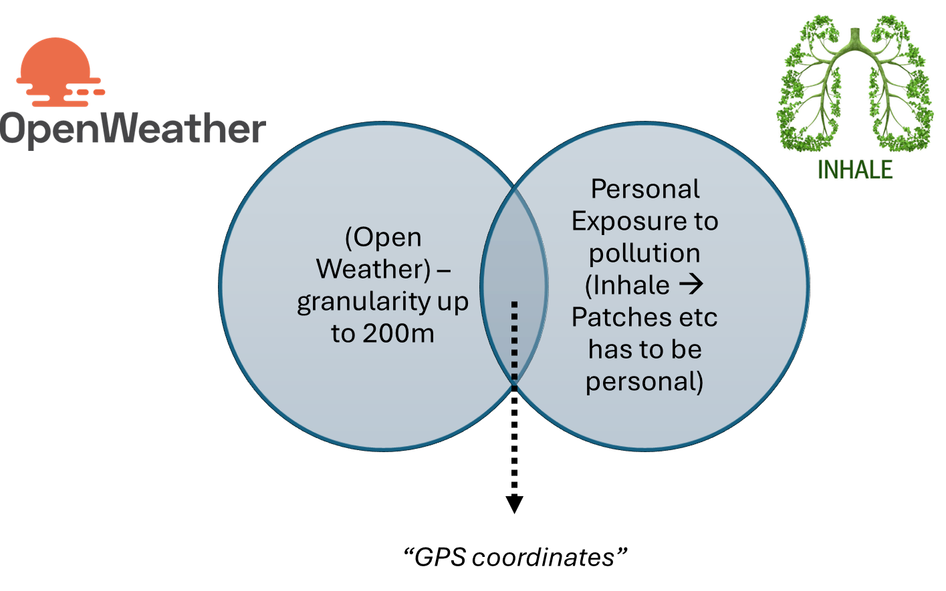

Slide 20
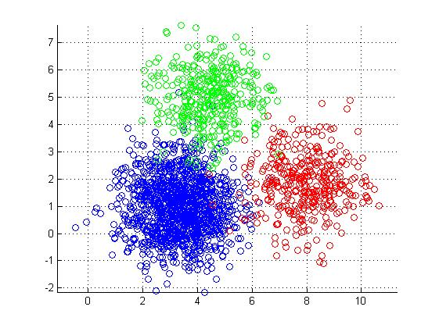
Project Plan
Data Ingestion & EDA
K-clustering classes identification
Transformer
Fine Tune x individual
“First Evaluation”
“Second Evaluation”
Healthy class
PM2
CO
Predicted HRV, skin etc

Slide 21
Data Ingestion & EDA
K-clustering classes identification
Transformer
Fine Tune x individual
“First Evaluation”
“Second Evaluation”
Healthy class
PM2
CO
Predicted HRV, skin etc

Slide 22
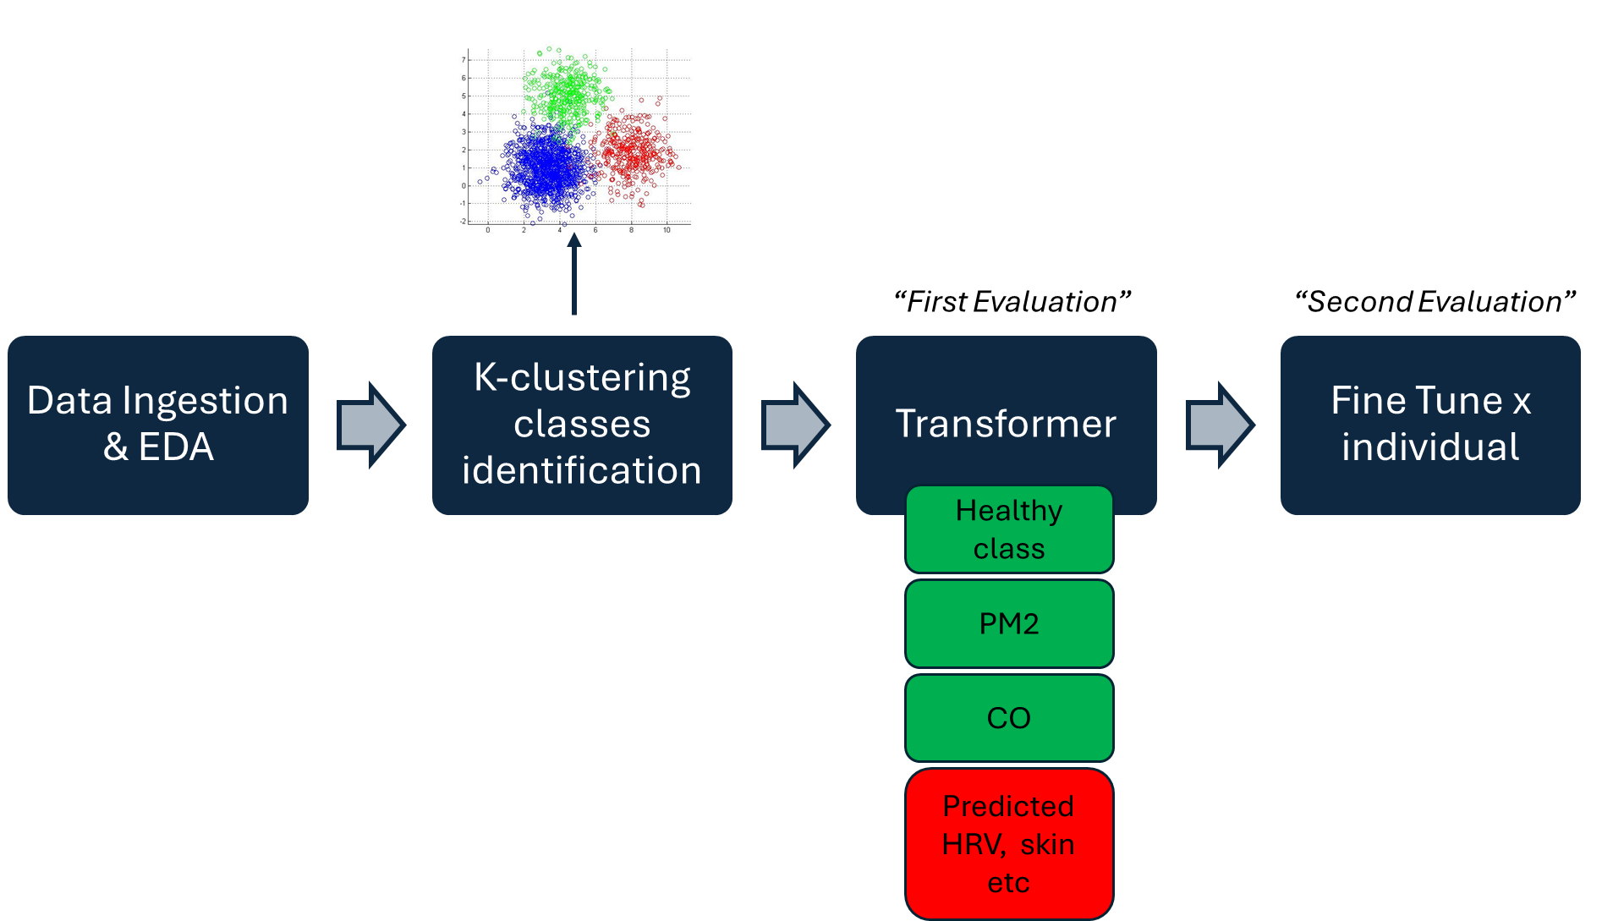
Classifier and Transformer based architecture

Slide 23
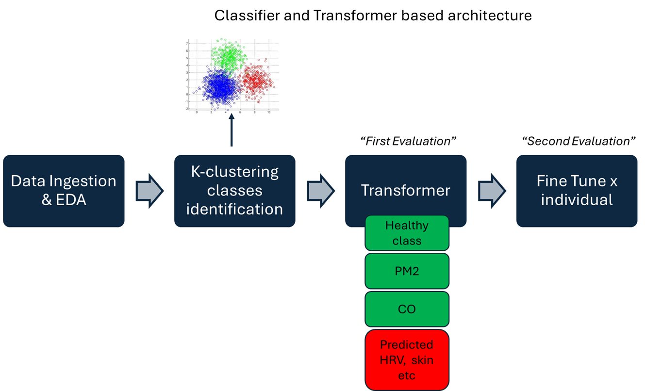

Slide 24
General Model Design – First Model
Input Vector (including physiological variables, pollution measures and individual health class)
Transformer Encoder (including positional encoding, stacked encoder blocks)
Latent Space with Transformer encoder-decoder
Transformer Decoder (including positional encoding, decoder blocks)
“Multi-head attention”
“Learned mapping between pollution and physical response”
“Prediction of future states”
Notes:
Loss Function: Cross-Entropy Loss
The Transformer is trained using the cross-entropy loss, which measures the difference between the predicted output probabilities and the true labels.

Slide 25
The final Plan
Input Vector (including physiological variables, pollution measures and individual health class)
Encoder (including positional encoding, stacked encoder blocks)
Latent Space with Transformer encoder-decoder – This has to be VAE
Transformer Decoder (to predict next Breath rate steps) and then what?
“Multi-head attention”
“Learned mapping between pollution and physical response”
“Prediction of future states”
Notes:
Loss Function: Cross-Entropy Loss
The Transformer is trained using the cross-entropy loss, which measures the difference between the predicted output probabilities and the true labels.

Slide 26
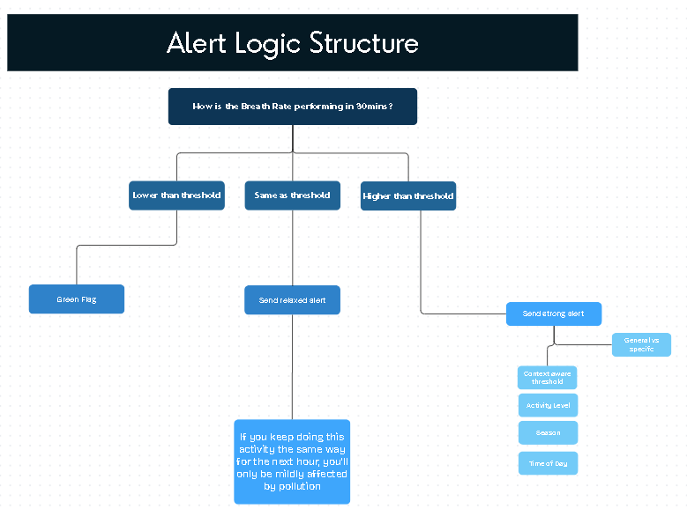
The final Plan
Notes:
Loss Function: Cross-Entropy Loss
The Transformer is trained using the cross-entropy loss, which measures the difference between the predicted output probabilities and the true labels.

Slide 27
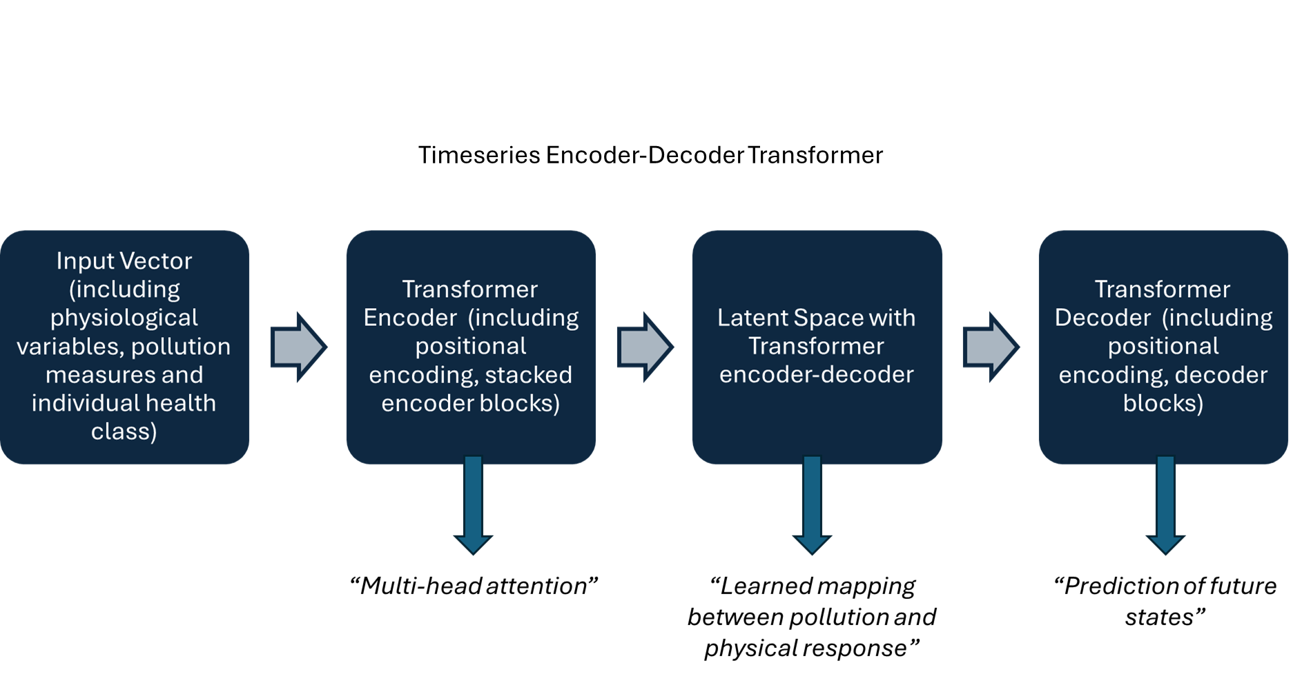

Slide 28

Timeseries Encoder-Decoder Transformer

Slide 29
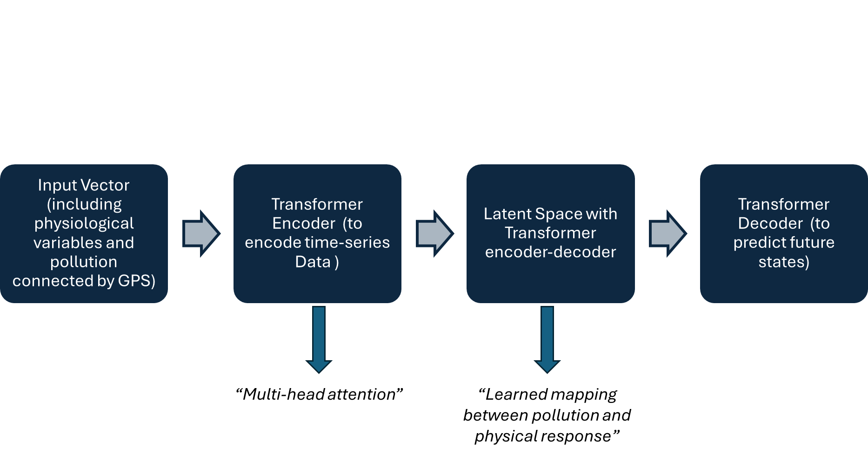

Slide 30
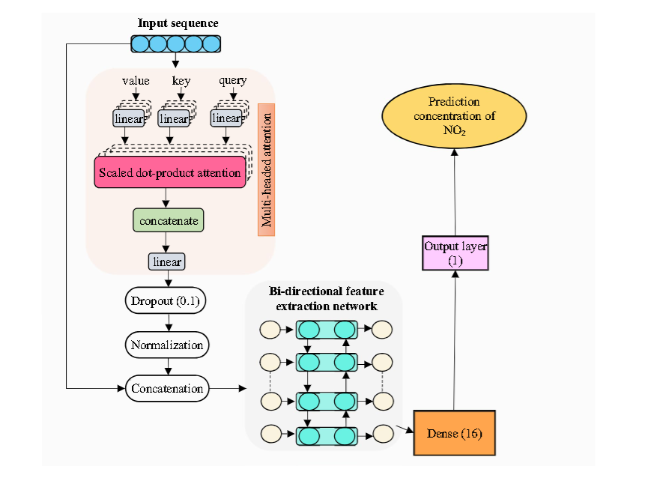
A bidirectional LSTM encoder-decoder transformer
Notes:
BREATH‑Net: a novel deep learning framework for NO2prediction using bi‑directional encoder with transformer

Slide 31
Timeline
Exploratory Data Analysis and literature Review
June
Data Preprocessing and Model training
July
Models' evaluation and Report writing
August

Slide 32
Model Architecture design
Transformer VAE on processed dataset
Push Latent Space
Freeze Last layers
Fine tune to fitbit data

Slide 33
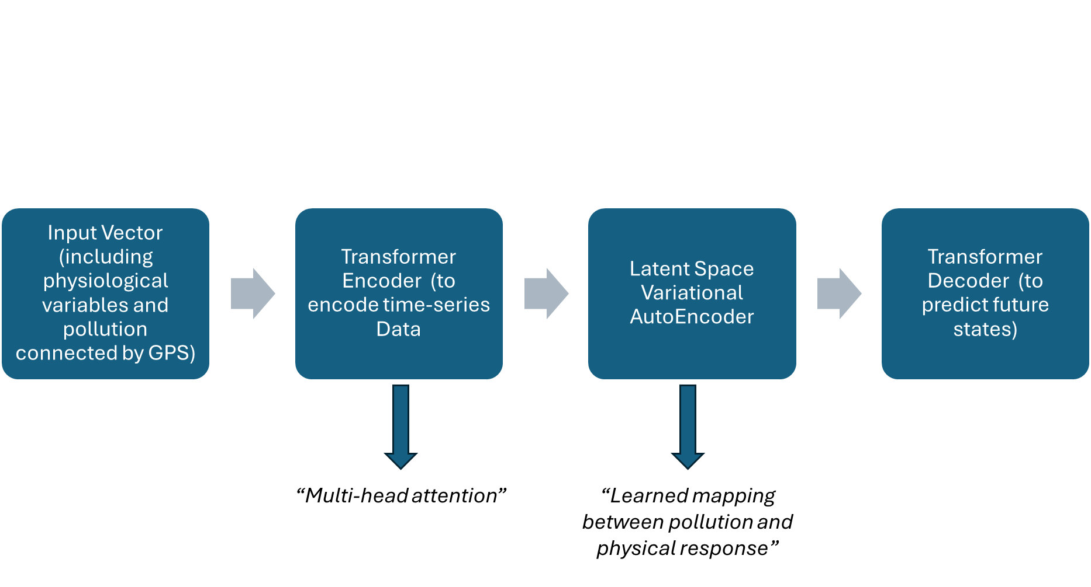
General Model Design – First Model
Notes:
Loss Function: Cross-Entropy Loss
The Transformer is trained using the cross-entropy loss, which measures the difference between the predicted output probabilities and the true labels.

Slide 34
Model Plan
Data Ingestion & EDA
K-clustering classes identification
Variational Autoencoder
Fine Tune x individual
“First Evaluation”
“Second Evaluation”
“Healthy class”
PM2
CO etc
(Predicted HRV, HR, skin etc)

Slide 35
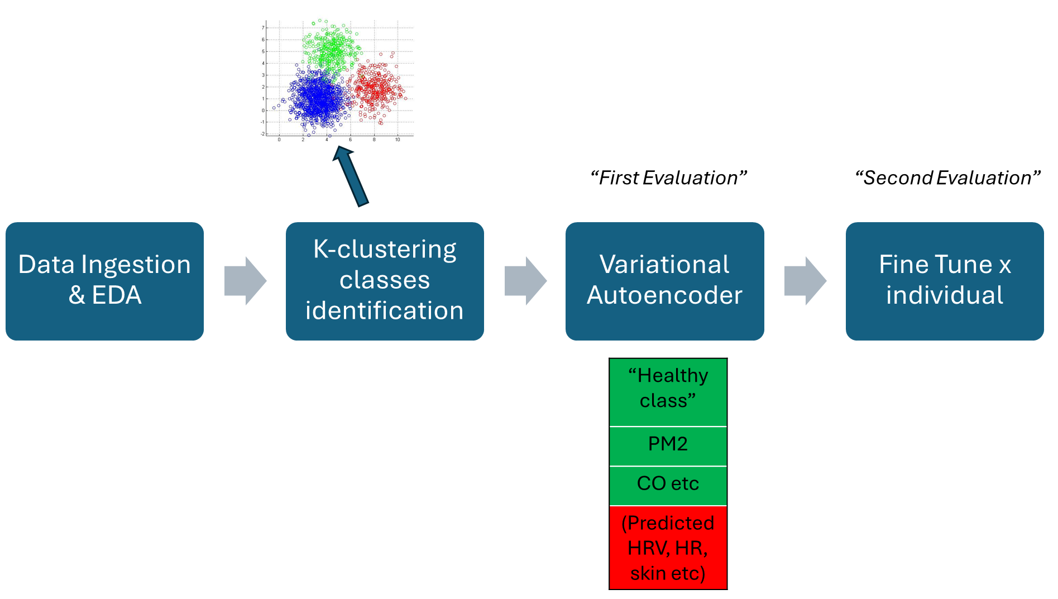

Slide 36
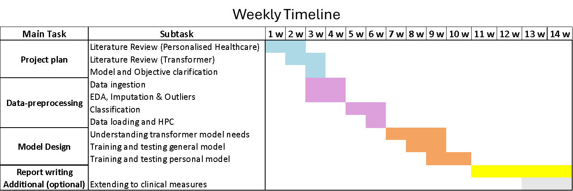
Weekly Timeline

Slide 37
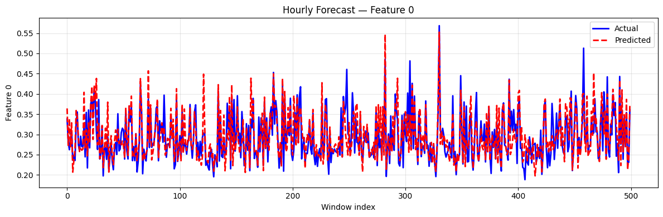

Slide 38
Questions
Are we supposed to merge the two datasets together? And if yes is it on time? Or how do we link pollution vs physical response? We do have a breadth both app
Also, do we get the data at least every second? Maybe – check the dataset
Does It make sense to classify the people in category? Since I am feeding it to the VAE – wouldn’t that also increase error propagation?
We are doing predictions of health responses based on pollution – why are we not using transformers time series or lstm? It’s time series data!

Slide 40
The final Plan
Input Vector (including physiological variables, pollution measures
Customer Transformer Encoder
Variational Latent Space (GAN)
Transformer Decoder (to predict next Breath rate steps) and then what?
A traditional Transformer Encoder, customized to retrieve attention weights. Including:
Multi-head self attention
Feedforward Network
Normalization and dropout
Notes:
Loss Function: Cross-Entropy Loss
The Transformer is trained using the cross-entropy loss, which measures the difference between the predicted output probabilities and the true labels.

Slide 41
Customer Transformer Encoder
A traditional Transformer Encoder, customized to retrieve attention weights. Including:
Multi-head self attention
Feedforward Network
Normalization and dropout

Slide 42
Latent Space is created
Took the last step of the latent space and got:
Got the mean of it
Got the variance of it
Now my latent space (thanks to the reparameterization technique) reflects a Gaussian Normal Distribution.

Slide 43
Latent Space becomes Variational
The latent step (last step of encoder) now becomes Variational with a GAN’ s technique.
Indeed, during the training loop we have a:
Generator = it learns to generate latent variables z from data that look like they came from a standard normal distribution (N(0, I)).
Discriminator = learns to tell apart real latent samples (from a true normal distribution ) from fake latent samples generated by the model.

Slide 45
Sequential Decoder
The decoder takes the latent vector z, which encodes information from the input time series, and maps it back into the future sequence of predictions.
It uses a simple feedforward network to transform this compressed representation into a multi-step forecast covering all output features.

Slide 46
Input Vector (including physiological variables, pollution measures
Customer Transformer Encoder
Variational Latent Space (GAN)
Transformer Decoder (to predict next Breath rate steps) and then what?
A
B
C
D
A traditional Transformer Encoder, customised to retrieve attention weights. Including:
Multi-head self attention
Feedforward Network
Normalization and dropout

Slide 47
A
The input includes tot number of features
To the input I will add Positional Encoding

Slide 48
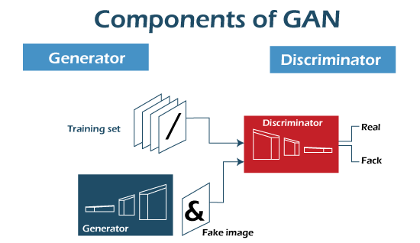
Encoder
6 transformer encoder layers with 8 heads x layer + position-wise feedforward dmodel → dff → dmodel with Relu and dropout
Variational Latent Space
Input
Transformation
Decoder
Output
μ
log(σ)
Z = μ +ε×σ
Reparam trick
Encoder’s output
Last step
Latent vector
Multivariate Sequence Input (T x B x F)
e.g. Breath rate avg, pm2.5, cyclical time etc.
Embedding
(128 dim)
Autoregressive forecasting with scheduled sampling
Future physiological and pollution states
Positional Encoding
h1
h2
h3
h4
h5
h6
h7
h8

Slide 49
Hybrid Transformer-Gan model for physiological and time-series forecasting
Transformer Encoder
6 transformer encoder layers with 8 heads x layer + position-wise feedforward dmodel → dff → dmodel with Relu and dropout
Variational Latent Space
Input
Transformation
Sequential Decoder
Output
μ
log(σ)
Z = μ +ε×σ
Reparam trick
Encoder’s output
Last step
Latent vector
Multivariate Sequence Input (T x B x F)
e.g. Breath rate avg, pm2.5, cyclical time etc.
Embedding
(128 dim)
Autoregressive forecasting with scheduled sampling
Future physiological and pollution states
Positional Encoding
h1
h2
h3
h4
h5
h6
h7
h8

Slide 50
Transformer Encoder
3 transformer encoder layers with 4 heads x layer + position-wise feedforward dmodel → dff → dmodel with Relu and dropout
Variational Latent Space
Input
Transformation
Sequential Decoder
Output
μ
log(σ)
Z = μ +ε×σ
Reparam trick
Encoder’s output
Last step
Latent vector
Multivariate Sequence Input (T x B x F)
e.g. Breath rate avg, pm2.5, cyclical time etc.
Embedding
(64 dim)
Autoregressive forecasting with scheduled sampling
Future physiological and pollution states
Positional Encoding
h1
h2
h3
h4

Slide 51
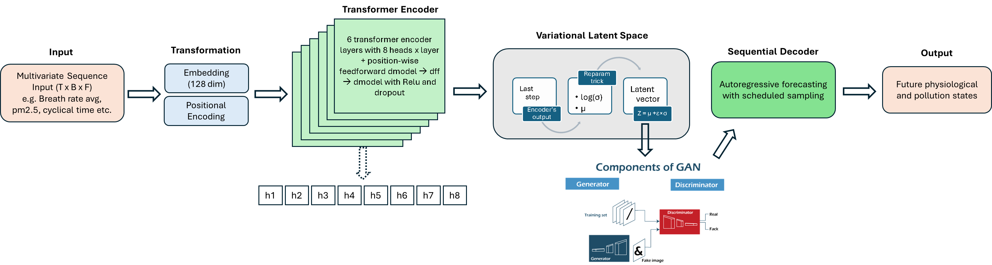
Hybrid Transformer-Gan model for physiological and time-series forecasting

Slide 53
U
Useful for bla bla
Log
Z = μ +ε×σ
Latent Variable Space
Final encode state
Something to say

Slide 54
Variational Latent Space
Autoregressive forecasting with scheduled sampling
Future physiological and pollution states
log(σ²)
Final encoder state
Z = μ +ε×σ
μ

Slide 55
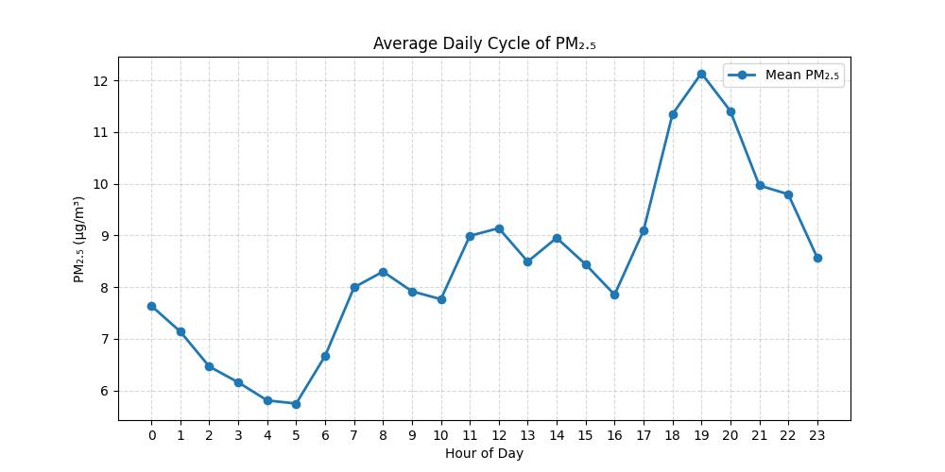
Inhale
The input includes tot number of features
To the input I will add Positional Encoding

Slide 56
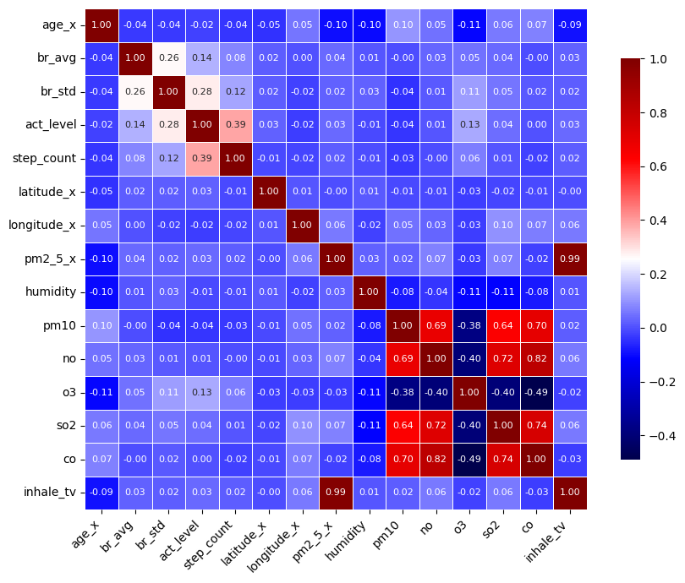
Correlation Matrix
Correlation Matrix between features

Slide 57
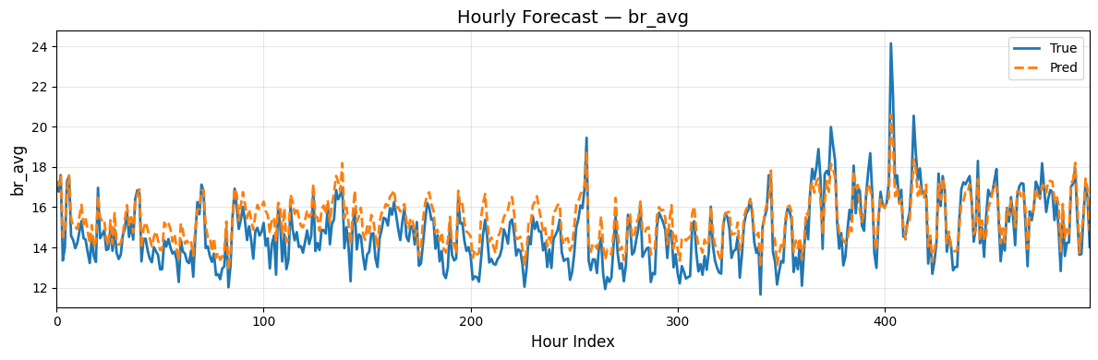
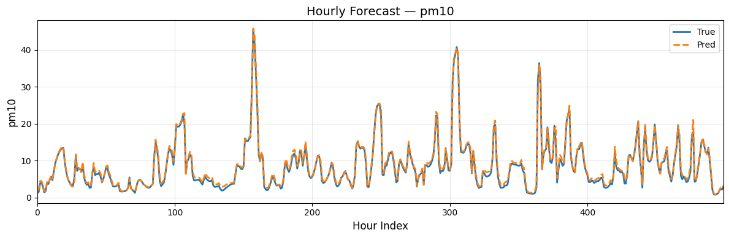
Hourly forecast general model

Slide 58
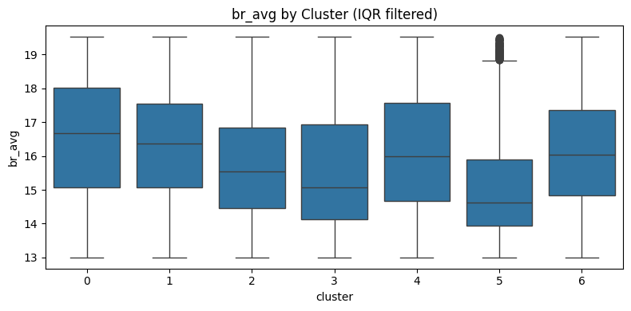
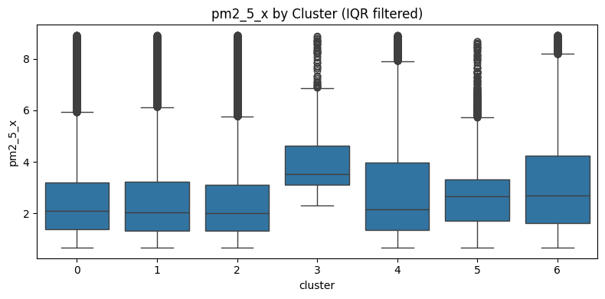
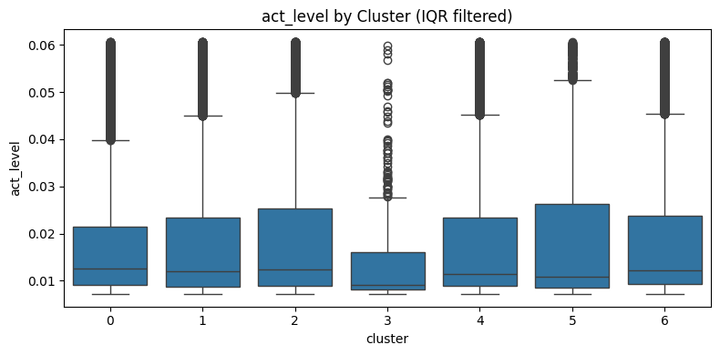
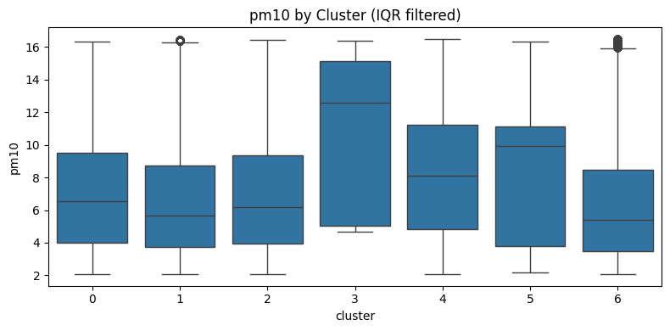
Dsitribution all individuals

Slide 59
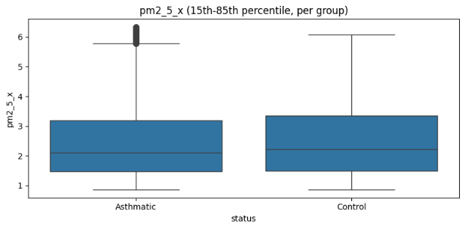
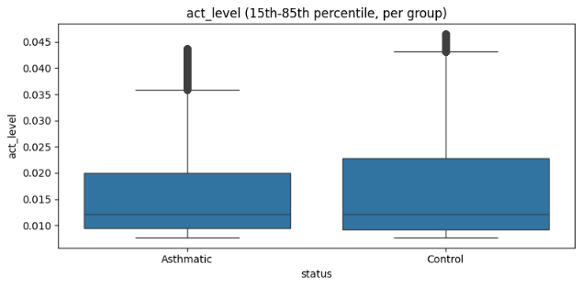
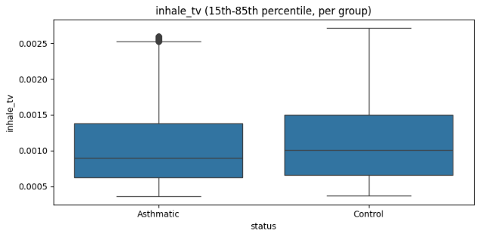
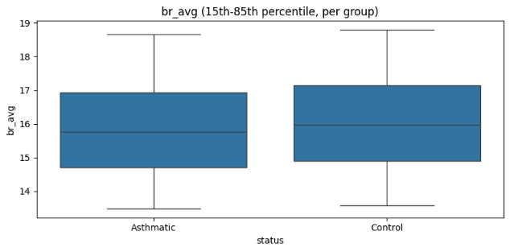
v

Slide 60
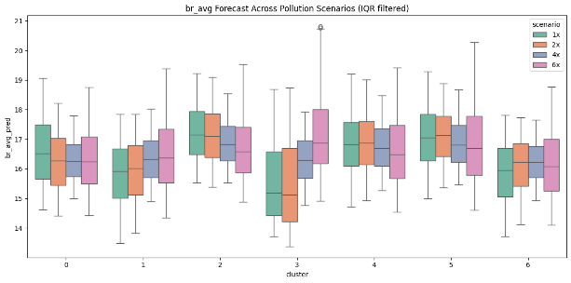
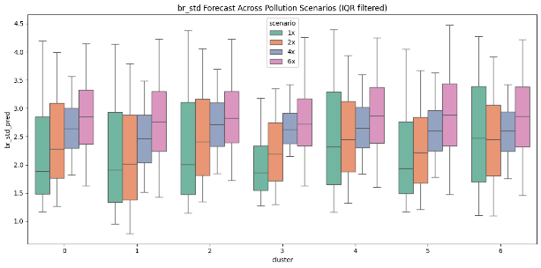

Slide 61
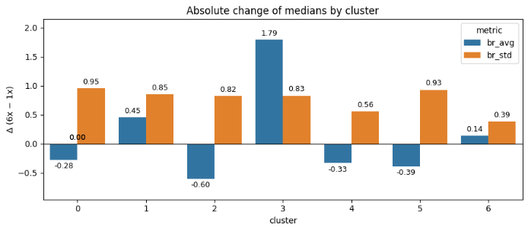
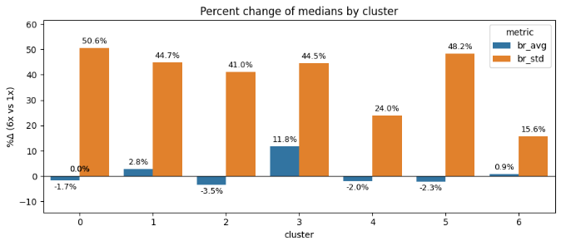

Slide 62
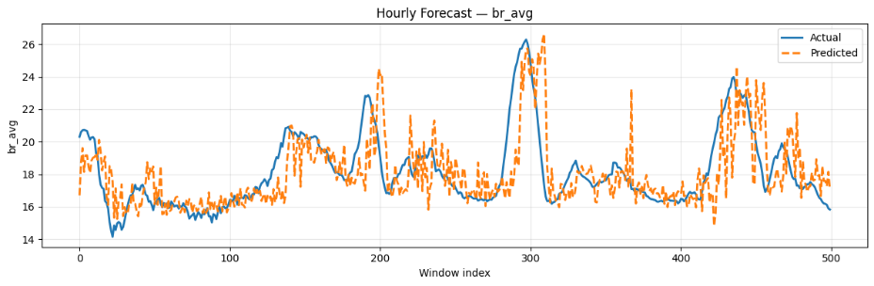
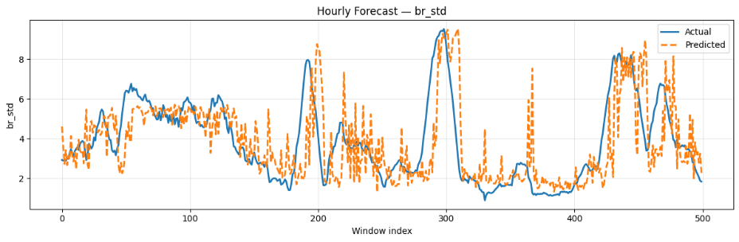

Slide 63
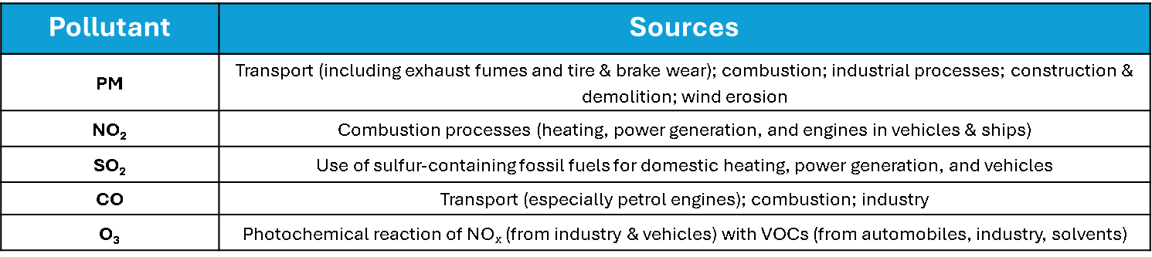
Pollutant | Sources
PM | Transport (including exhaust fumes and tire & brake wear); combustion; industrial processes; construction & demolition; wind erosion
NO₂ | Combustion processes (heating, power generation, and engines in vehicles & ships)
SO₂ | Use of sulfur-containing fossil fuels for domestic heating, power generation, and vehicles
CO | Transport (especially petrol engines); combustion; industry
O₃ | Photochemical reaction of NOₓ (from industry & vehicles) with VOCs (from automobiles, industry, solvents)

Slide 64
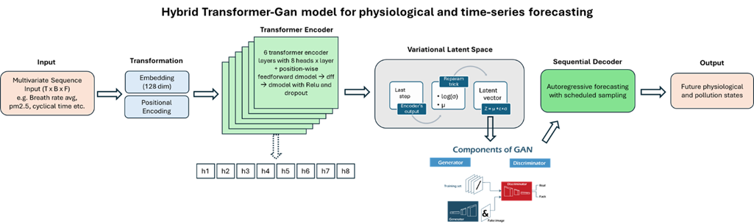

Slide 65



Slide 66


Slide 67



Slide 68


Slide 69



Slide 70


Slide 71



Slide 72





Slide 73



